Slide 1
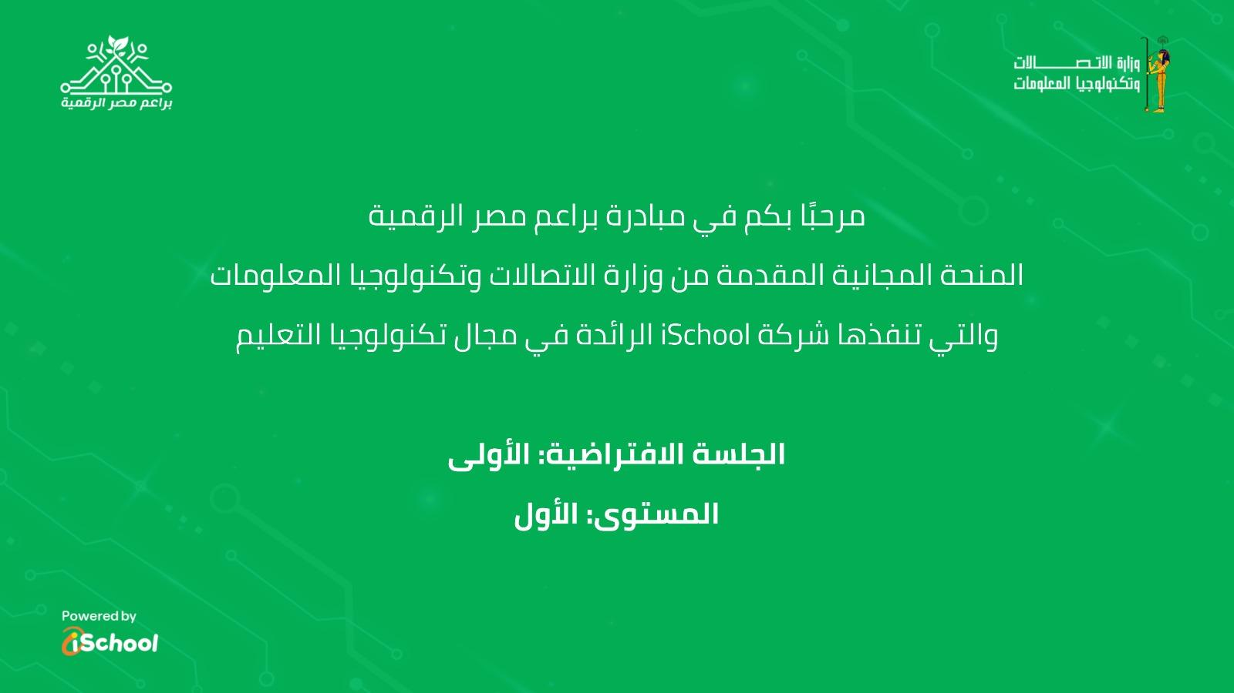
Intro to Computer Science
DEMI G4S1-Lesson 3–Sprites in Action (Events).
الجلسة التطبيقية: الأولى
المستوى: الثالث

Slide 2
Introduction to Game Development with Python
DEMI G6S1-Lesson 9 – Physical Session / Project

Slide 3
Introduce yourself
Tell us your name, age/grade, and your hobbies
Spin the wheel
Open the random wheel
Answer the random question on the screen
Notes:
https://wheelofnames.com/eqj-8zc

Slide 4


Slide 5
9
Do fun unplugged activities
Understand what are games
Make a simple project on mblock
Assessment quiz

Slide 6
Let’s do a recap using.. puzzles?

Slide 7
Let’s solve the crosswords

Slide 8
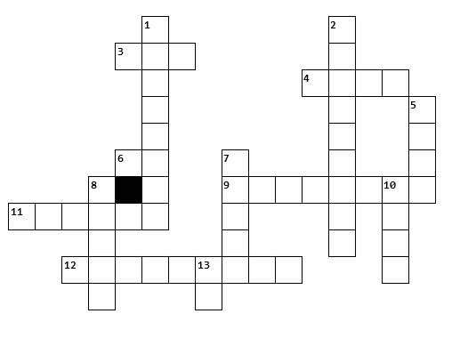
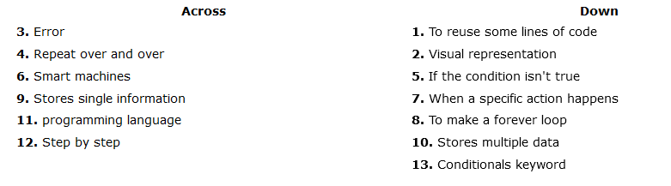
Solve Crosswords

Slide 9
Great job!

Slide 10
Time for another fun activity

Slide 11
Drawing Algorithm

Slide 12
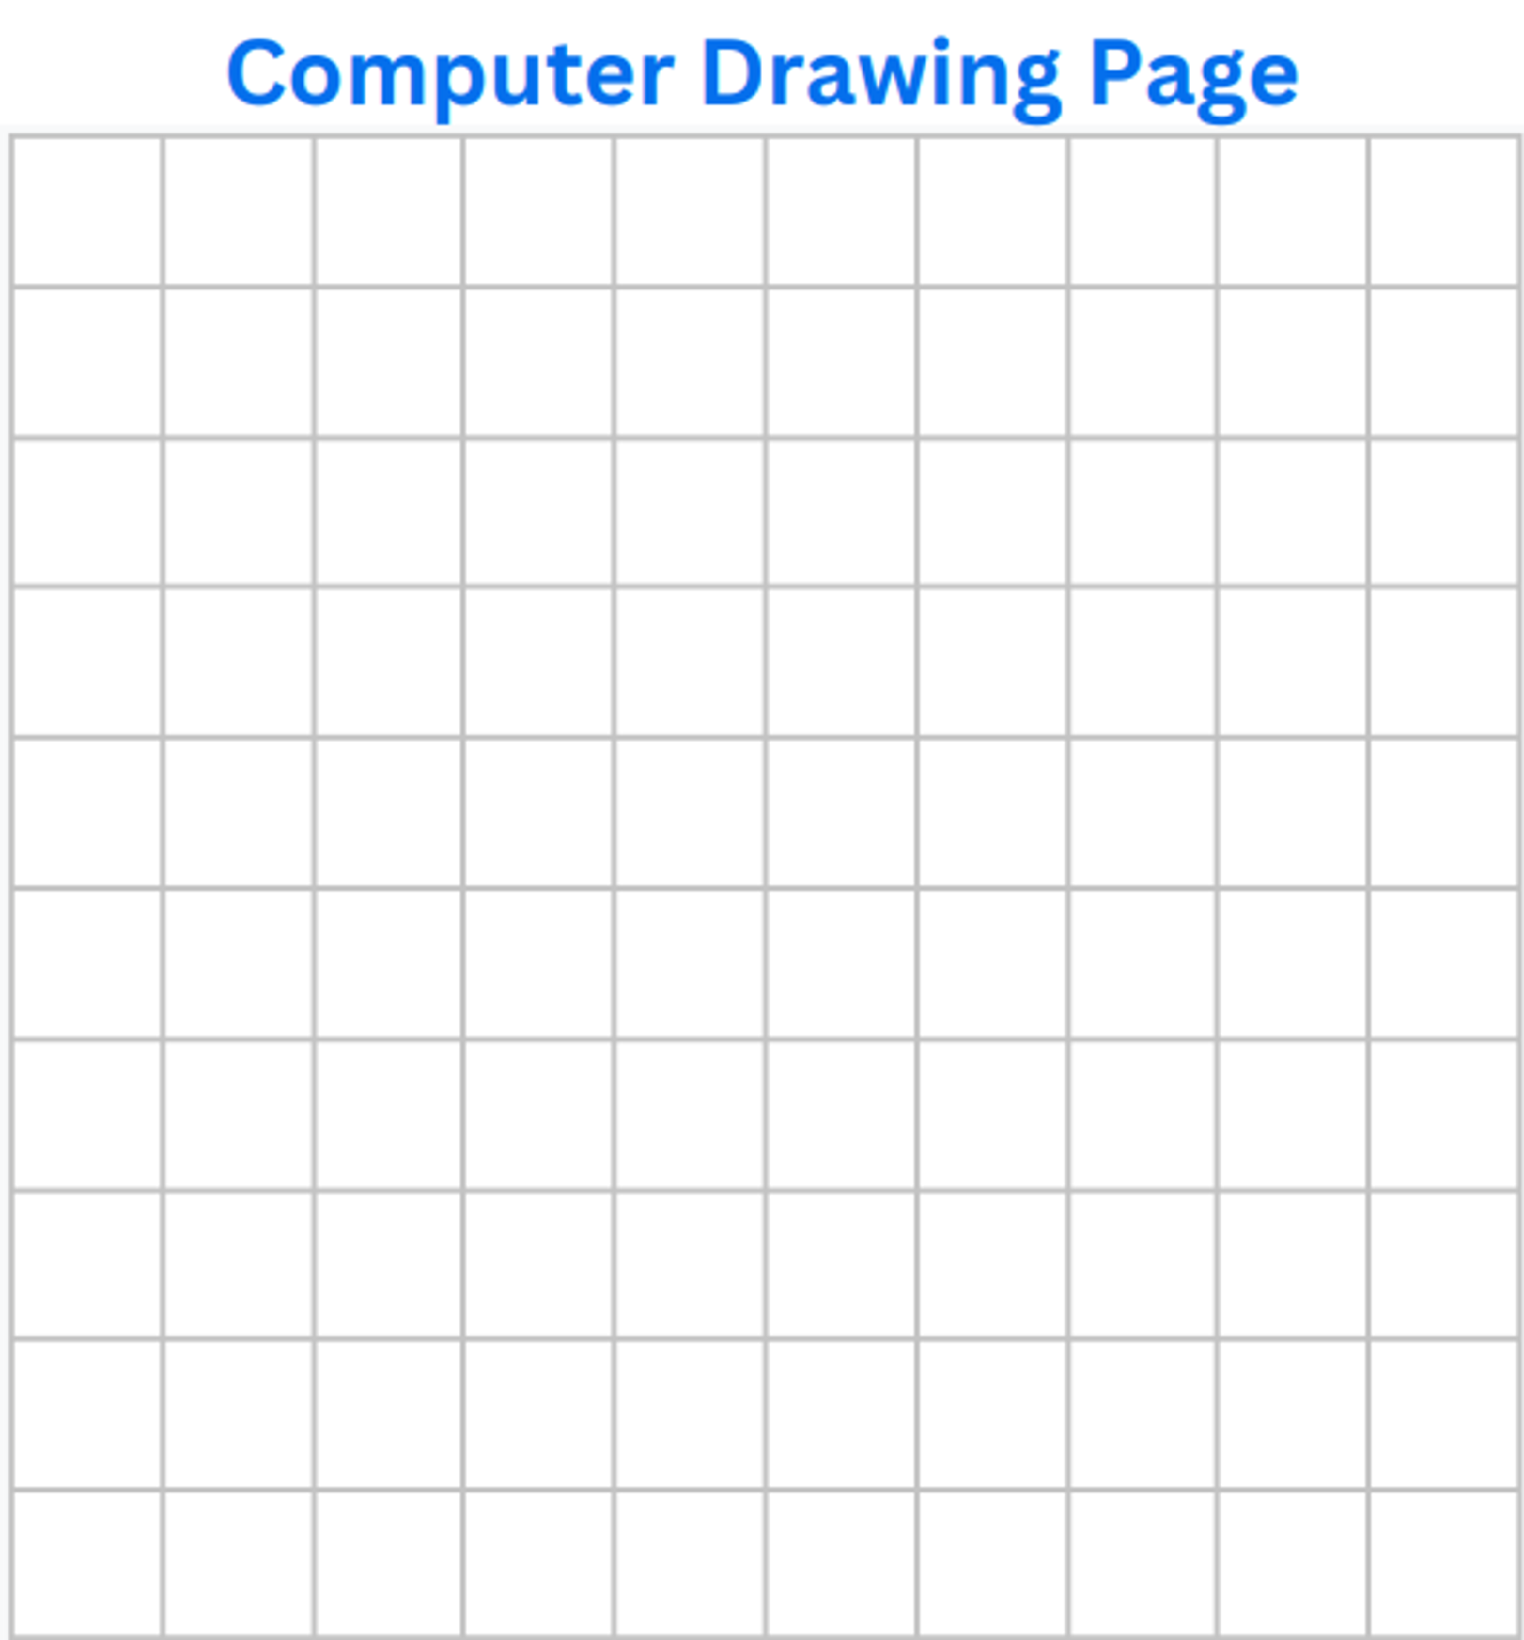
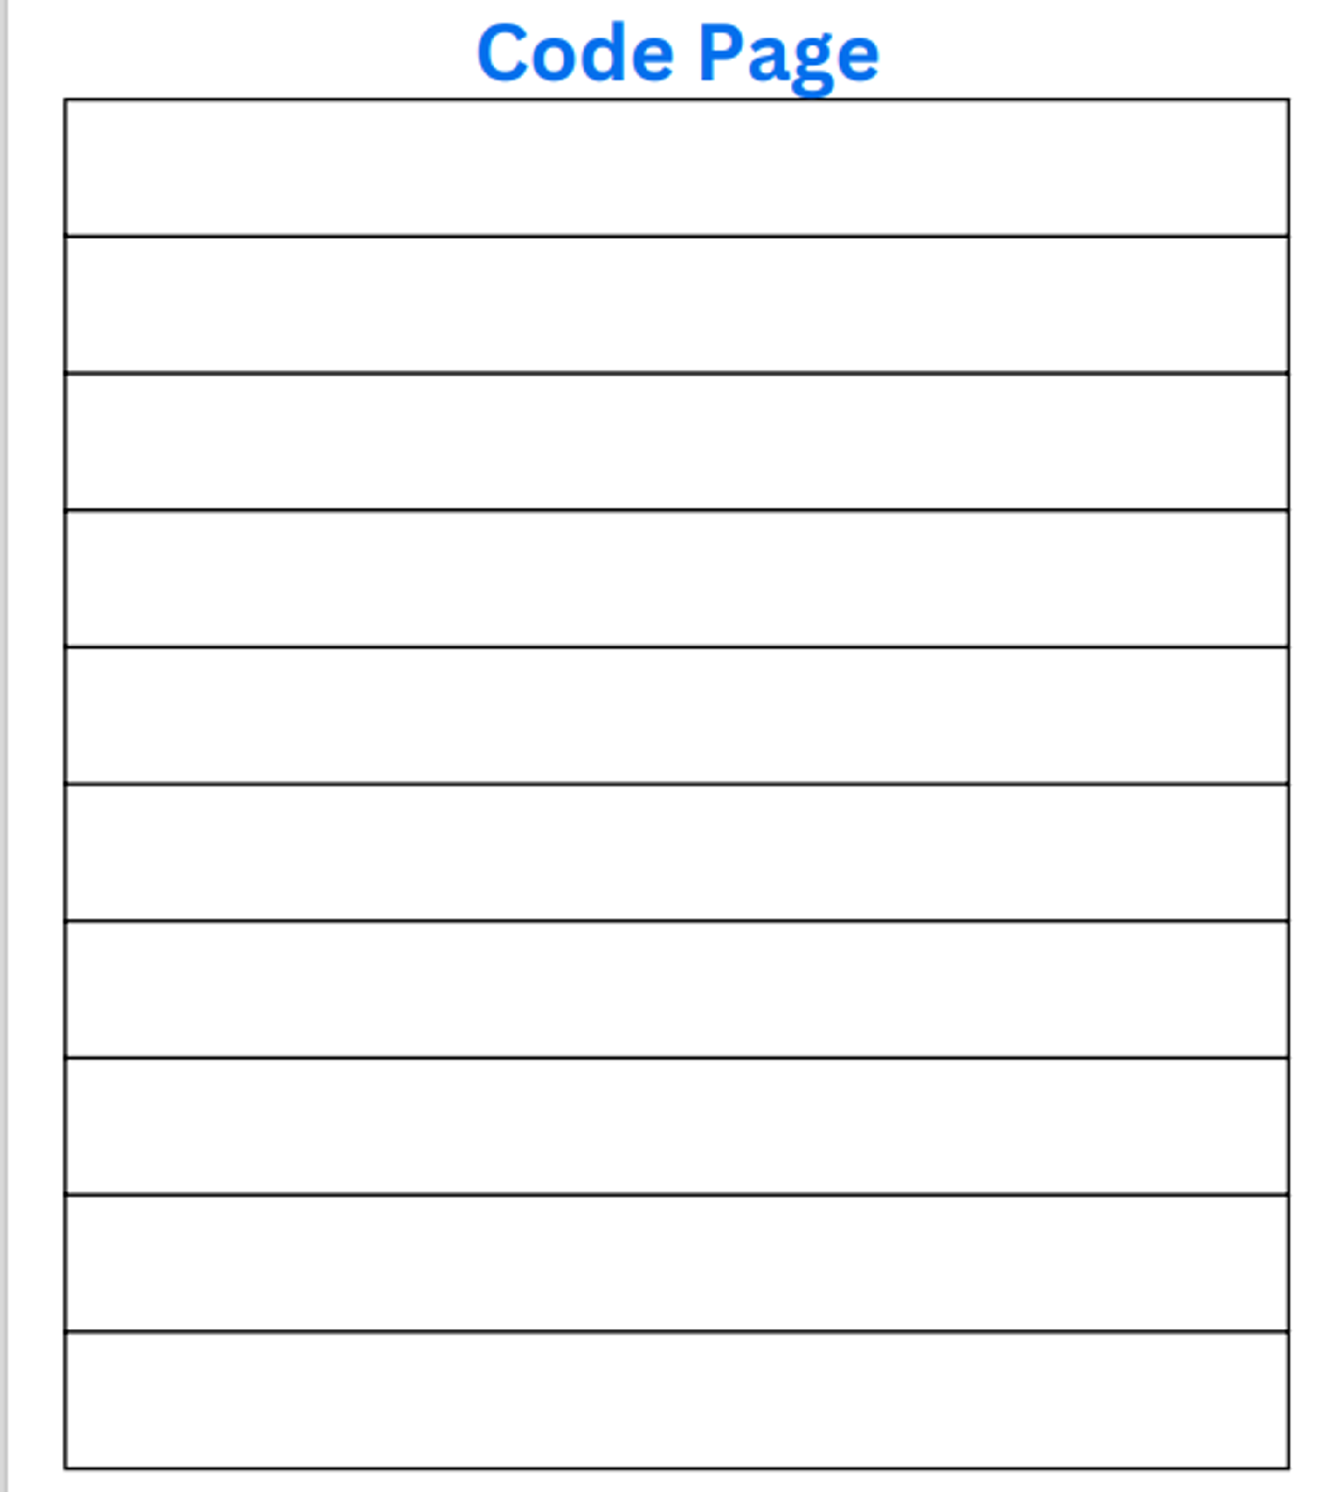
Drawing Algorithm

Slide 13

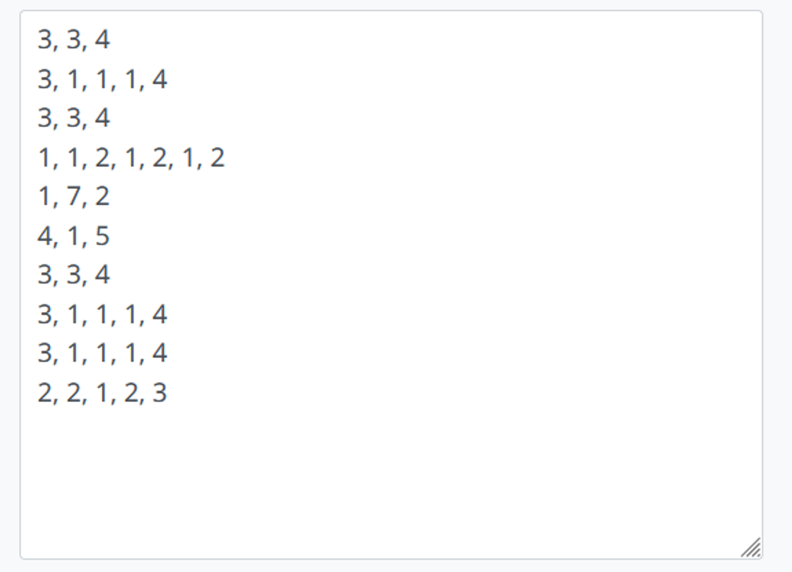
Drawing Algorithm

Slide 14

15 دقائق

Slide 15
Have you ever thought what is a game?
Notes:
Games are a type of software

Slide 17
Games are software
(a type of program)

Slide 18
So, how are softwares made?

Slide 19
Softwares go through something called SDLC
(Software development life cycle)

Slide 20
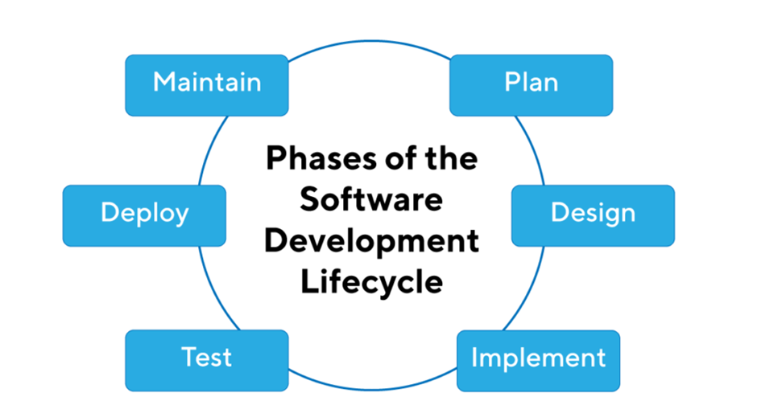
Software development life cycle

Slide 21
But still, how games are made..

Slide 22
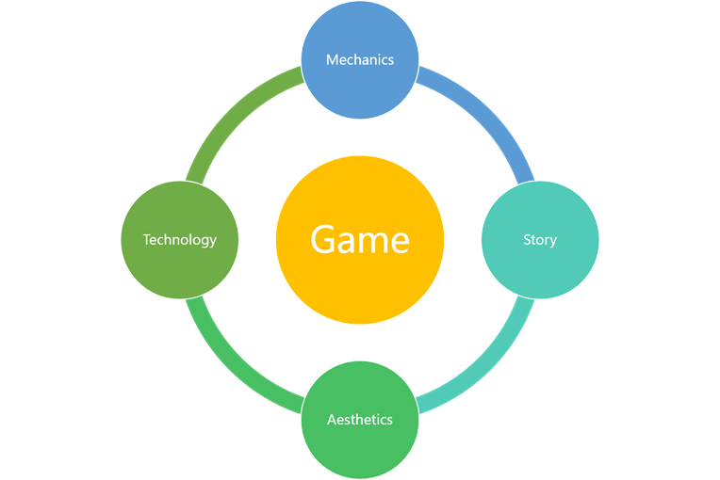
Game design
First, decide what the game is going to look like and how it would work

Slide 23
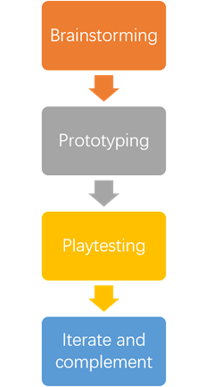
Game development life cycle
Then, develop the game

Slide 24
Let’s design and develop our game!

Slide 25
Let’s start with designing our game!

Slide 26
Choose a game to make!
(choose only 1 idea)

Slide 27
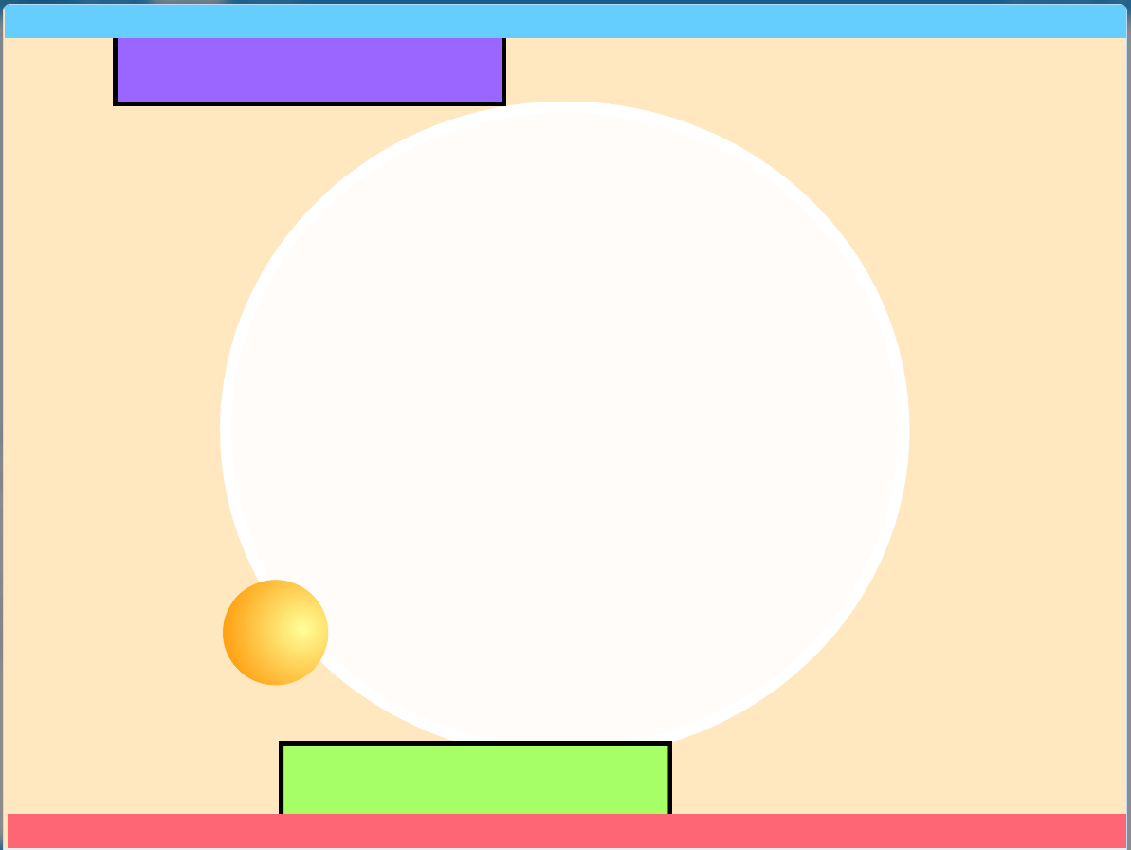
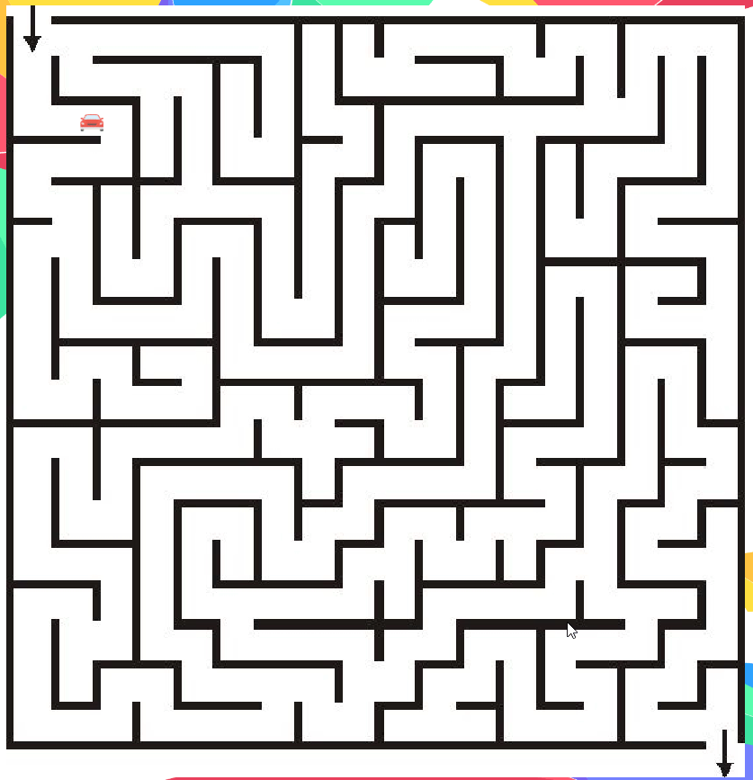
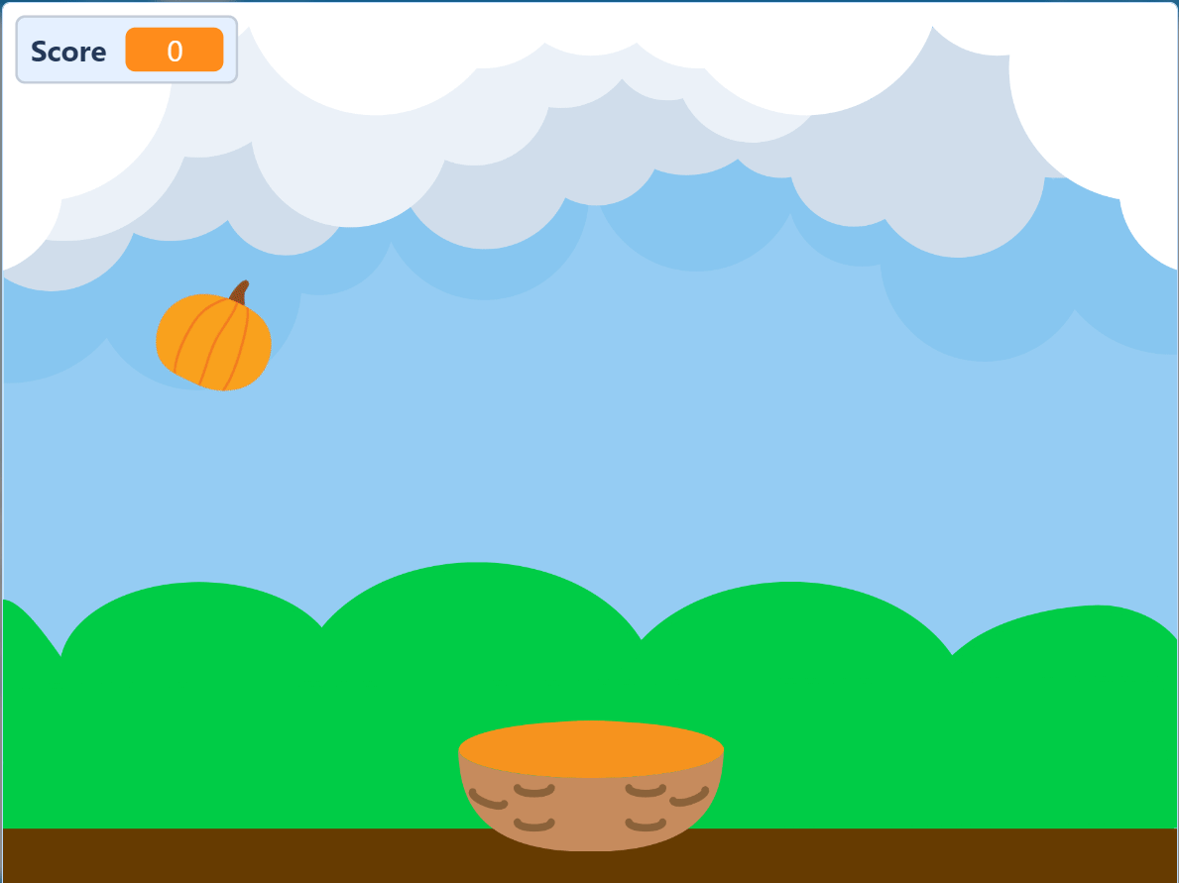
Choose a game idea

Slide 28

Design your own game
Make
Choose a game idea
Choose sprites and background for your game
Think how each sprite will move
Notes:
(You can share with students)
Resources for sprites and game assets:
https://craftpix.net/freebies/ (sprites)
https://www.flaticon.com/search?word=icecream (sprites)
https://mixkit.co/free-sound-effects/win/ (game sounds)

Slide 29
Great! let’s develop our game!

Slide 30

Develop your game!
Make it real
Develop the game.
Debug
Run your game to test it

Slide 31
Time for the Quiz!

Slide 33


